Slide 1
DESIGN PORTFOLIO
This presentation shows a part of my designs which I have made, and its application
Sree Eswarr Kailash S.K
Mech Eng, VIT -2025

Slide 2
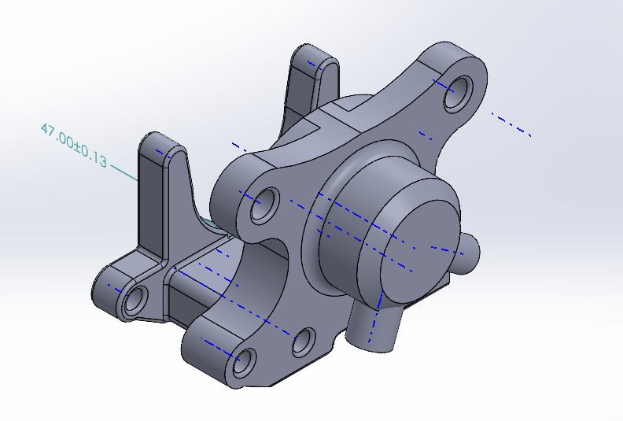
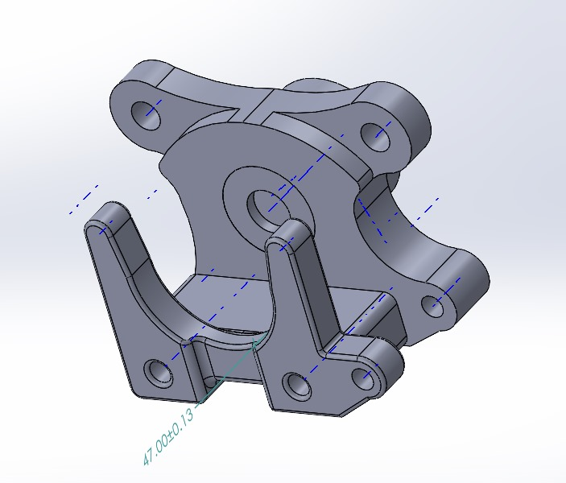
1. FLOATING CALIPER
Type: Single piston floating caliper
Material: Aluminium 7075-T6
Brake fluid: Dot 4
Technical Specification: The caliper is made in consideration of the bleed screw port facing upwards to remove air.
Reference: The cad model was made based on the reference from other OEM Calipers.
Application: It is used in BAJA ATV vehicles, which works efficiently even with dirt on it

Slide 3
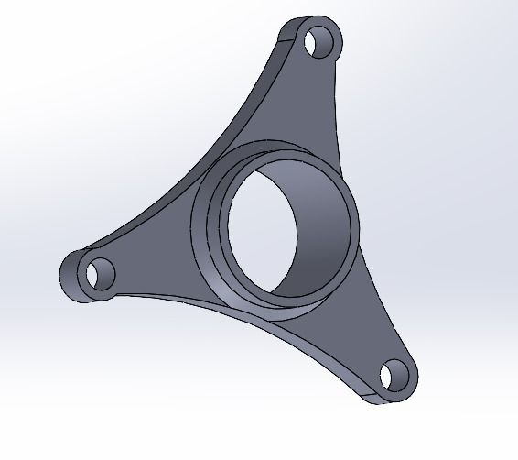
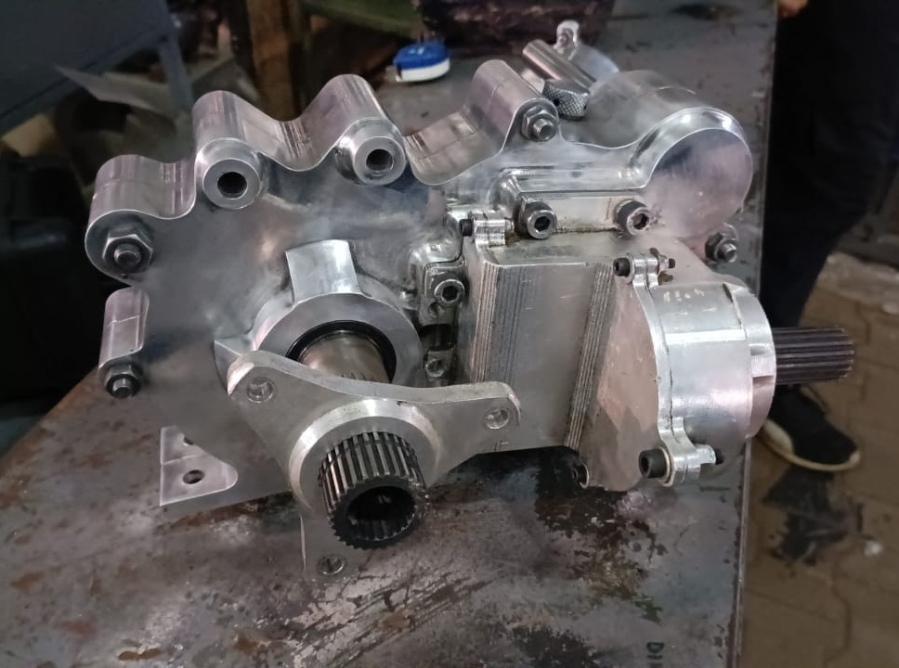
2 .ROTOR FLANGE
Type: Rear rotor flange
Material: Aluminium 7075-T6
Technical Specification: It is used as an intermediate part to hold the brake rotor with the output shaft from the gear box.
Use: The rotor flange was made as it was in-board braking with a single rotor in the rear section of the car.
A caliper mounting design was integrated with the gear box to reduce the complexity of the caliper mount.

Slide 4
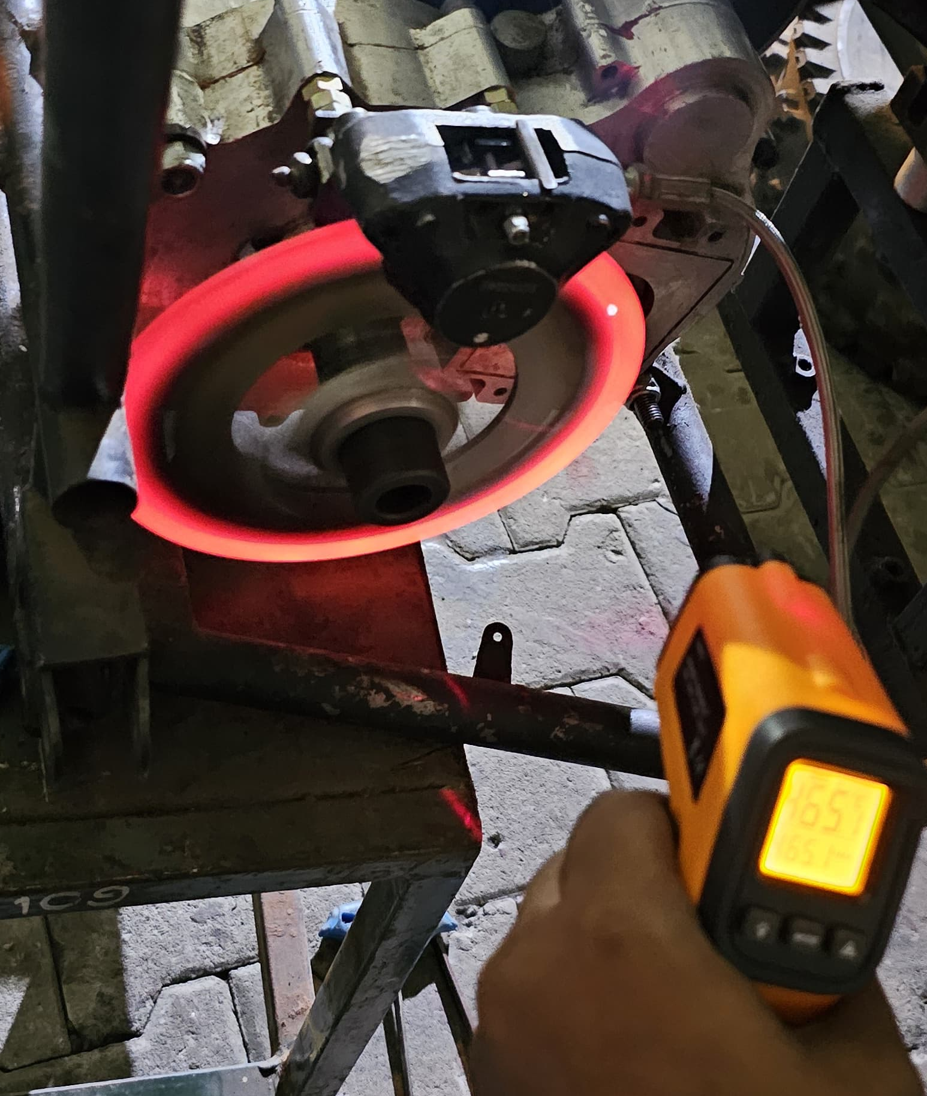
3. TESTING OF BRAKE ROTOR
Type: Fixed Brake Rotor
Material: Stainless Steel
Technical Specification: It is made by considering the weight of the vehicle, maximum speed and cutouts are made for heat dissipation.
Application: It is mounted on the gearbox output shaft.
Component Designed, Manufactured, Tested and Implemented for BAJA

Slide 5
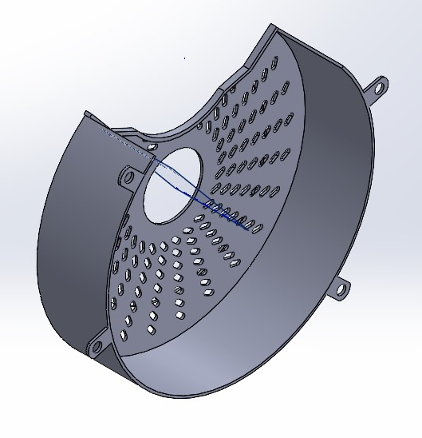
4. IN BOARD ROTOR GUARD
Type: Rotor Finger Guard
Material: Mild steel
Use: It is used to protect the rotor from external dirt and to protect the user from getting injured while the rotor is running .
This guard is mounted on the gear box which again reduces the complexity of the mounting.

